Slide 1
Geochemistry of Calcareous Fens in the Minnesota River Basin
Hunter J. Hubrig
Michael L. Ginsbach

Slide 2
Overview
Introduction
Overview of Paper
Effects of Nitrogen Runoff
Effects of Groundwater Arsenic
Effects of CO₂ Concentration
Conclusion
Questions

Slide 3
What is a Calcareous Fen?
A fen is a particular type of wetland that is fed either by surface water or groundwater. The water in these wetlands is neutral or alkaline.
A calcareous fen is a very rare type of fen that is characterized by having groundwater which is rich in calcium and magnesium.
The particular calcium-rich geochemistry of these waters leads to unique plant communities called “calciphiles”, which means calcium loving.
These calcareous fens are very fragile environments – many things can disrupt the natural ecosystems found within.

Slide 4
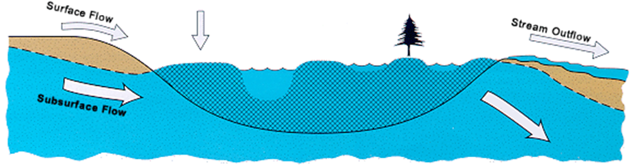
What is a Calcareous Fen?
Fens receive both surface and subsurface waters. Because of this, fens tend to reflect the chemistry of the underlying geology. They can be quite alkaline when fed from limestone sources.

Slide 5
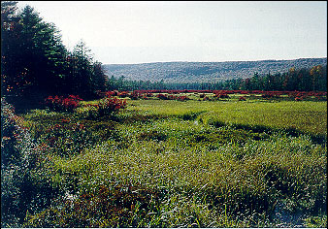
What is a Calcareous Fen?

Slide 6
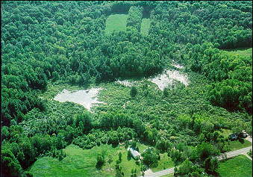
What is a Calcareous Fen?

Slide 7
Overview of Paper
This article focuses on peat characteristics and groundwater geochemistry of 5 calcareous fens in the state of Minnesota.
Two of these fens were in the western part of the state, and the other three were located in the eastern portion of Minnesota.

Slide 8
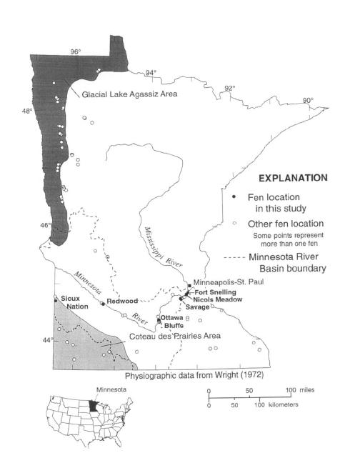

Slide 9
Overview of Paper - Peat
The article we selected, which focuses mainly on groundwater geochemistry, also touches briefly on the peat characteristics of the fen.
Peat, an accumulation of partially decayed plant matter, is deposited in this area. The peat from calcareous fens has high levels of carbonate in the upper and lower layers, but the middle levels were carbonate depleted.*
Based on radiocarbon dating, the peat accumulated in our select fens between 4700 and 11,000 years BP. The age ranges occur due to climate change and local hydrogeologic conditions.

Slide 10
Overview of Paper – Groundwater Geochemistry
The basis of the geochemical analysis is to focus on what substances are being brought into and out of our fen – water is running into the fen on one side and out on the other.
Measurements were taken of the individual species of the western fens and eastern fens.
Saturation indexes of calcite, dolomite, and gypsum were presented to give us an idea of the levels of these important minerals in our calcareous fens.

Slide 11
Additional Research to Paper
To expand on the information presented within our paper, we decided to focus on agricultural factors that could negatively impact the fragile environments found within our calcareous fens.
Because of geographic location, only the western fens were considered – they are located in prime agricultural regions. The eastern fens are located in more urban areas, where farming is not a major industry. These eastern fens have also been disturbed much more than the fens in the west.

Slide 12
Effects of Nitrogen Runoff
To check the possible impact the agricultural industry could have on the fragile environment of the fens, we decided to increase the amount of nitrate and ammonium, two common components of fertilizer.
We compared output of the initial measurements taken from the water table level measurements of the western fens to the output created from PHREEQC when we increased the amounts of these nitrogen compounds.

Slide 13
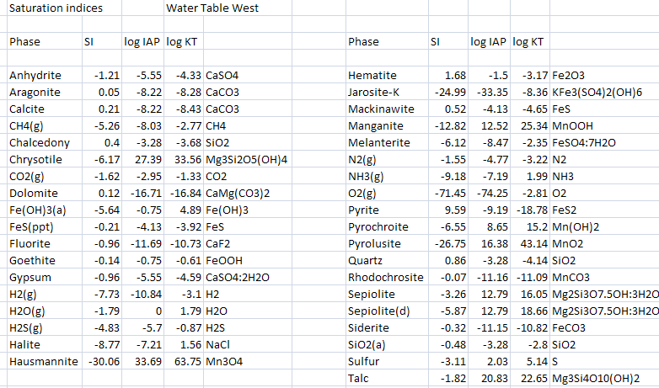
Effects of Nitrogen Runoff

Slide 14
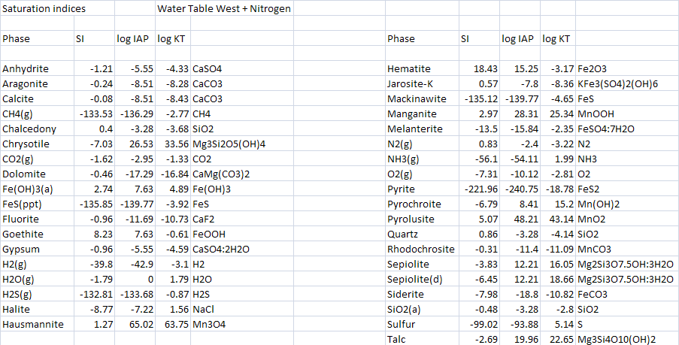
Effects of Nitrogen Runoff

Slide 15
Effects of Nitrogen Runoff
Mineral | SI in Water Table West | SI in Water Table West + N | Δ SI
Calcite | 0.21 | -0.08 | -0.29
Dolomite | 0.12 | -0.46 | -0.58
Gypsum | -0.96 | -0.96 | 0

Slide 16
Effects of Groundwater Arsenic
Another possible environmental factor that could potentially damage our calcareous fens is arsenic in the groundwater.
This potentially dangerous element can occur naturally in groundwater and find its way into the fens.
To model this, we added .03 ppm arsenic (which is three times the legal limit allowed in ground water) to the measurements taken from the subpeat wells in the western fens.

Slide 17
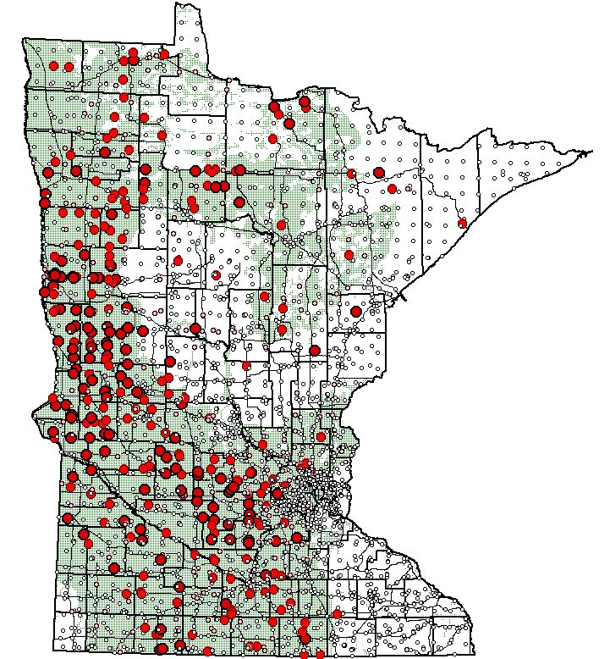

Sioux Nation
Redwood

Slide 18
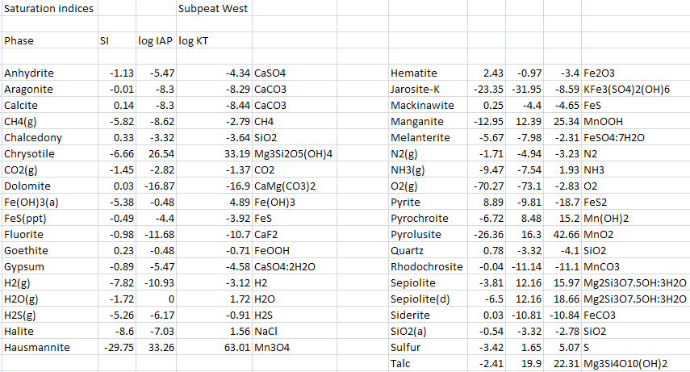
Effects of Groundwater Arsenic

Slide 19
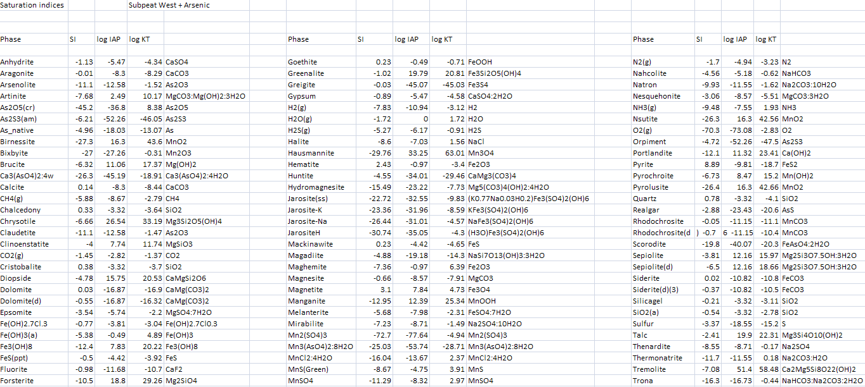
Effects of Groundwater Arsenic

Slide 20
Effects of Groundwater Arsenic
Arsenic Minerals | SI in Subpeat West + Arsenic | Formula
Arsenolite | -11.06 | As2O3
As2O5(cr) | -45.18 | As2O5
As2S3(am) -6.21 | -6.21 | As2S3
Arsenic Trioxide- reduces to arsenic, oxidizes to give arsenic pentoxide.
Arsenic Pentoxide- dissolves in water to form arsenic acid.
Arsenic Trisulfide- oxidizes to form layer of arsenic trioxide at water surface .

Slide 21
Effects of Groundwater Arsenic
Mineral | SI in Subpeat West | SI in Subpeat West + Arsenic | Δ SI
Calcite | 0.14 | 0.14 | 0
Dolomite | 0.03 | 0.03 | 0
Gypsum | -0.89 | -0.89 | 0

Slide 22
Effects of CO₂ Concentration
The article proposes that calcareous fens are in danger of being harmed by increasing levels of CO₂ in the atmosphere.
It was stated within the article that within 100 years the p_{CO2} may double from the current level.
Increasing the amount of CO₂ could have disastrous effects on the fens, by potentially modifying the amount of calcite, dolomite, and gypsum within the waters.
To determine these effects, we decided to model this CO₂ increase using PHREEQC.

Slide 23
Effects of CO₂ Concentration

Slide 24
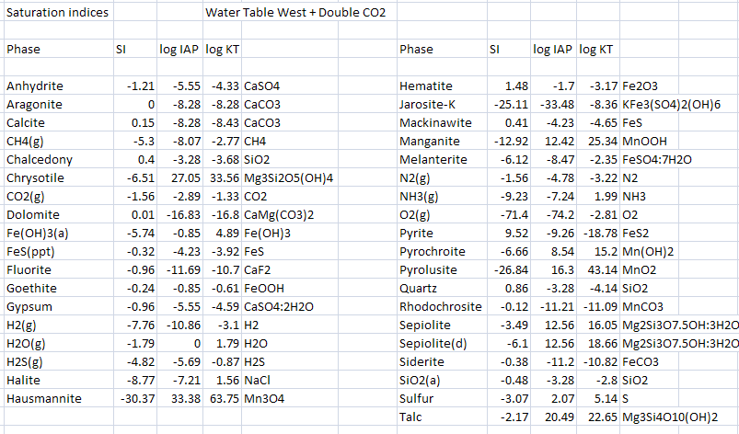
Effects of CO₂ Concentration

Slide 25
Effects of CO₂ Concentration
Mineral | SI in Water Table West | SI in Water Table West + Doubled CO₂ | Δ SI
Calcite | 0.21 | 0.15 | -0.06
Dolomite | 0.12 | 0.01 | -0.11
Gypsum | -0.96 | -0.96 | 0

Slide 26
Effects of CO₂ Concentration
H2O + CO2 ⬄H2CO3
The increase of CO2 in the atmosphere will cause more CO2 reacting with water, producing elevated levels of carbonic acid in the solution.
The high levels of carbonic acid will in turn dissolve more calcite in our solution and lower our SI.

Slide 27
Conclusion
Based upon our additional modeling, we found out what could possibly happen to these calcareous fens if environmental conditions change.
If nitrogen runoff from agricultural industry happens, the saturation of calcite, dolomite, and gypsum can change, throwing the fen out of its normal state. Eutrophication can also happen due to increased nitrogen.

Slide 28
Conclusion
If arsenic is introduced into the fen, there is no change in the saturation of calcite, dolomite and gypsum. However, many new minerals are introduced into the groundwater, which can possibly have negative impacts upon the fen.
In the situation that CO₂ concentration is increased, the saturations of calcite, dolomite, and gypsum will be changed, causing the conditions of the fen to differ.

Slide 29
Conclusion
Calcareous fens are a rare but interesting part of our environment. They have very unique varieties of vegetation . These areas are extremely fragile, however, and even small changes in the environment can damage them.
As we found out through our modeling, there are many different situations that could impact the conditions of these fens.

Slide 30
References
Consumer Factsheet on: NITRATES/NITRITES . (2006, November 28). Retrieved November 24, 2008, from U.S Environmental Protection Agency: http://www.epa.gov/OGWDW/contaminants/dw_contamfs/nitrates.html
Erickson, M. (n.d.). Arsenic in Minnesota Groundwater. Minneapolis , Minnesota, USA.
James E. Almendinger, J. H. (1998). Peat characteristics and groundwater
geochemistry of calcareous fens in the Minnesota River Basin, U.S.A., Biogeochemistry , 17-41.
Komor, S. C. (1994). Geochemistry and hydrology of a calcareous fen within
the Savage Fen wetlands complex, Minnesota, USA. Geochimica et Cosmochimica , 3353-3367.
USGS . (2008, October 15). Retrieved November 24, 2008, from Trace
Elements National Synthesis Project: http://water.usgs.gov/nawqa/trace/arsenic/

Slide 31


